Slide 1
Power electronic an drives: ELEC 2208 – 2
Chapter 1: Electromagnetic and Mechanical Fundamentals
Dr Frederic Gardes
University of Southampton
2018-2019

Slide 2
Overview
Chapter 1 covers the following basic definitions:
  Moment of inertia
  Friction
  Path control
  Power transmission
  Torque balanced equation and kinetic energy
  Torque and kinetic energy
  Exemples of connectors
  Transducers

Slide 3
Motion Profiles
Requirement
A CNC machine tool, robot or related systems needs to incorporate the means of controlling the position of the actuator relative to a reference point to a high degree of accuracy. Without this accuracy the quality of the “process“ will be considerably reduced. Three basic strategies for path control can be employed:
  Straight cut
  Point-to-Point
  Contouring

Slide 4
Motion Profiles
Straight Cut
A straight cut control system is capable of moving parallel to one of the major axes at a fixed rate suitable for machining.
The control variable being the feed speed of the single axis.

Slide 5
Motion Profiles
Point-to-Point
In a point-to-point system, the trajectory of the movement is not important.
The control variables are the X and Y co-ordinates of the start and finish point

Slide 6
Motion Profiles
Definition
An indexing move consists of:
  Acceleration to speed
  Constant speed for a specific time
  Deceleration to standstill
  Dwell for a defined period of time

Slide 7
Motion Profiles
Trapezoidal

Slide 8
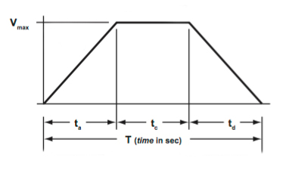
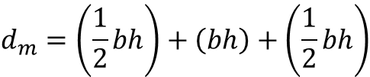


Motion Profiles
Trapezoidal
The trapezoidal move profile can be treated as three curves, or segments: acceleration (triangle), constant velocity (square), and deceleration (triangle). Therefore, the total DISTANCE travelled is the sum of the areas of the three curves:
$$d_{m}= d_{a}+d_{c}+d_{d}$$
Now, inserting the formulas for AREA of a triangle, square, and another triangle:
$$d_{m}=\left(\frac{1}{2}bh\right)+\left(bh\right)+\left(\frac{1}{2}bh\right)$$
In each segment, time represents the base (b), and maximum velocity represents the height (h), so we get:
$$t_{m}$$
$$d_{m}=\left(\frac{1}{2}t_{a}v_{max}\right)+\left(t_{c}v_{max}\right)+\left(\frac{1}{2}t_{d}v_{max}\right)=\left(\frac{1}{2}v_{max}\right)\left(t_{a}+t_{d}\right)+(v_{max}t_{c})$$

Slide 9
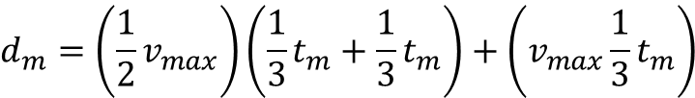



Motion Profiles
Trapezoidal
For the 1/3, 1/3, 1/3 profile, t_{a} = t_{c} = t_{d}, and each segment equals 1/3 of the total time, t_{m}. Thus, the equation becomes:
$$d_{m}=\left(\frac{1}{2}v_{max}\right)\left(\frac{1}{3}t_{m}+\frac{1}{3}t_{m}\right)+\left(v_{max}\frac{1}{3}t_{m}\right)$$
And simplifying, we get:
$$d_{m}=\frac{2}{3}t_{m}v_{max}$$
Maximum velocity
$$v_{max}=\frac{3}{2}\frac{d_{m}}{t_{m}}$$
Acceleration
$$t_{m}$$
Because the middle segment (square) is only for constant velocity (zero acceleration), the acceleration can be determined using either the left side triangle (for acceleration) or the right side triangle (for deceleration):
$$a_{max}=\frac{v_{max}}{t_{a}}=\frac{v_{max}}{tm/3}=\frac{3v_{max}}{t_{m}}$$

Slide 10
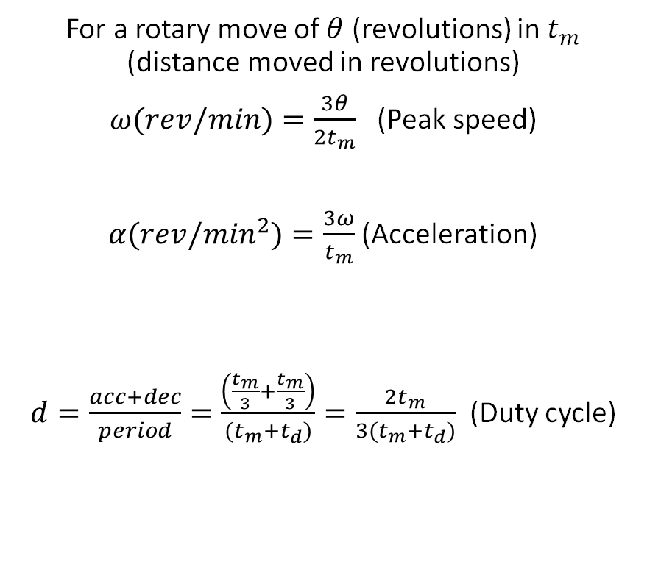
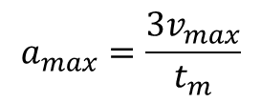

Motion Profiles
Relationships - trapezoidal
For a linear motion
For a rotary move of $θ$ (revolutions) in $t_{m}$ (distance moved in revolutions)
$ω(rev/min)=\frac{3θ}{2t_{m}}$ (Peak speed)
$α(rev/\min^{2})=\frac{3ω}{t_{m}}$ (Acceleration)
$d=\frac{acc+dec}{period}=\frac{\left(\frac{t_{m}}{3}+\frac{t_{m}}{3}\right)}{(t_{m}+t_{d})}=\frac{2t_{m}}{3(t_{m}+t_{d})}$ (Duty cycle)
$$v_{max}=\frac{3}{2}\frac{d_{m}}{t_{m}}$$
$$a_{max}=\frac{3v_{max}}{t_{m}}$$

Slide 11
Motion Profiles
Relationships - trapezoidal
For applications that benefit from a period of constant speed, a trapezoidal move profile offers the advantage of having a lower maximum velocity than a triangular profile.

Slide 12
Motion Profiles
Triangular

Slide 13
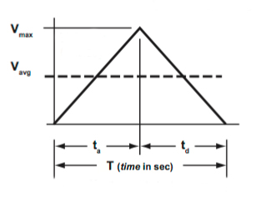

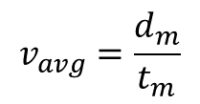
Motion Profiles
Triangular
The basic premise of a triangular move profile is to accelerate to a maximum speed, then immediately decelerate, with acceleration and deceleration being equal in terms of both time and distance.
In other words, if you want to move from here to there in the fastest time, you would use a triangular move profile. Determining any of the move variables—time, velocity, acceleration, or distance—is based on the geometry of the triangle.
Average velocity
Since the acceleration and deceleration time are equivalent, and there is no constant speed time, average velocity is simply total distance over total time:
$$v_{avg}=\frac{d_{m}}{t_{m}}$$
Maximum velocity
Maximum velocity is the height, or peak, of the triangle, and is twice the average velocity:
$$t_{m}$$

Slide 14



Motion Profiles
Triangular
Acceleration
Acceleration is the slope of one side of the triangle (“rise over run”). This is the maximum velocity divided by the acceleration time, which is half of the total move time:
Where t_{a} = ½ t_{m}
Therefore: $a=\frac{2vmax}{t_{m}}$
$$t_{m}$$

Slide 15
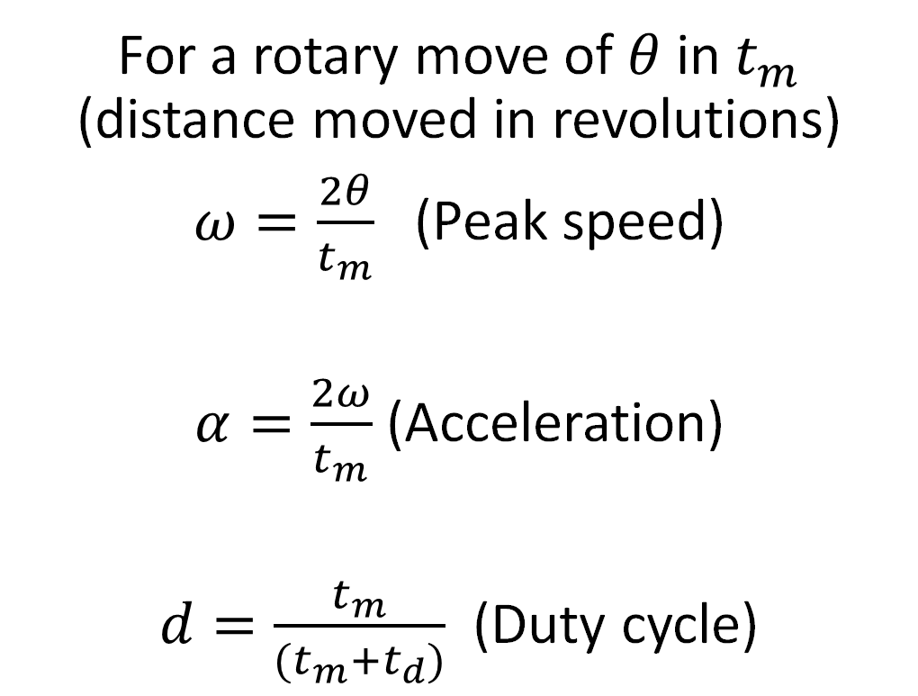
Motion Profiles
Relationships - Triangular
For a rotary move of $θ$ in $t_{m}$ (distance moved in revolutions)
$ω=\frac{2θ}{t_{m}}$ (Peak speed)
$α=\frac{2ω}{t_{m}}$ (Acceleration)
$d=\frac{t_{m}}{(t_{m}+t_{d})}$ (Duty cycle)

Slide 16
Motion Profiles
Relationships - Triangular
In addition to being the overall fastest option for getting from one point to the other, a triangular move profile requires lower acceleration than a trapezoidal profile, which translates to lower thrust forces on the drive unit.

Slide 17
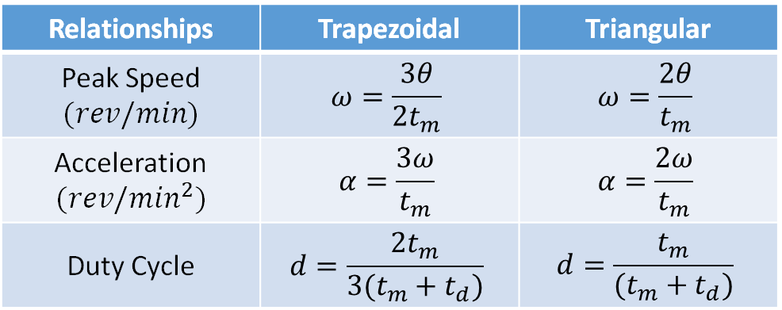
Motion Profiles
Trapezoidal – Triangular motion comparison
For a rotary move of $θ$ in $t_{m}$ (distance moved in revolutions)
Relationships | Trapezoidal | Triangular
Peak Speed $$(rev/min)$$ | $$ω=\frac{3θ}{2t_{m}}$$ | $$ω=\frac{2θ}{t_{m}}$$
Acceleration $$(rev/\min^{2})$$ | $$α=\frac{3ω}{t_{m}}$$ | $$α=\frac{2ω}{t_{m}}$$
Duty Cycle | $$d=\frac{2t_{m}}{3(t_{m}+t_{d})}$$ | $$d=\frac{t_{m}}{(t_{m}+t_{d})}$$
<
>
<

Slide 18
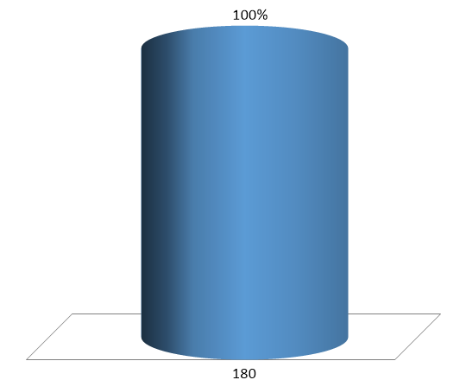

A disk is required to move from standstill, 90 degrees in 1 sec and then stop there, based on (a) a trapezoidal path; and (b) a triangular path. Find the peak speed and slope’s acceleration.
Example
$$ω$$
90º

Slide 19
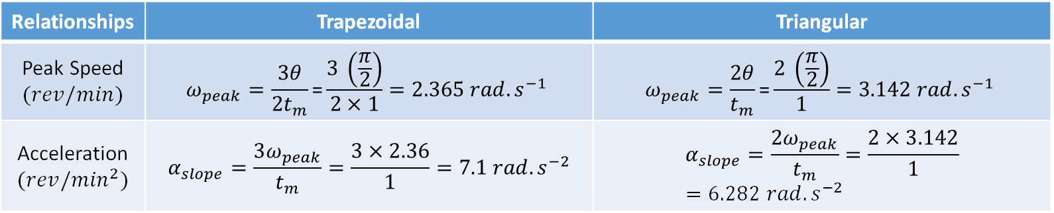

Example
A disk is required to move from standstill, 90 degrees in 1 sec and then stop there, based on (a) a trapezoidal path; and (b) a triangular path. Find the peak speed and slope’s acceleration.
Relationships | Trapezoidal | Triangular
Peak Speed $$(rev/min)$$ | $$ω_{peak}=\frac{3θ}{2t_{m}}\text{=}\frac{3 \left(\frac{π}{2}\right)}{2×1}=2.365 rad.s^{−1}$$ | $$ω_{peak}=\frac{2θ}{t_{m}}\text{=}\frac{2 \left(\frac{π}{2}\right)}{1}=3.142 rad.s^{−1}$$
Acceleration $$(rev/\min^{2})$$ | $$α_{slope}=\frac{3ω_{peak}}{t_{m}}=\frac{3×2.36}{1}=7.1 rad.s^{−2}$$ | $$α_{slope}=\frac{2ω_{peak}}{t_{m}}=\frac{2×3.142}{1}=6.282 rad.s^{−2}$$
$$ω$$
90º

Slide 20
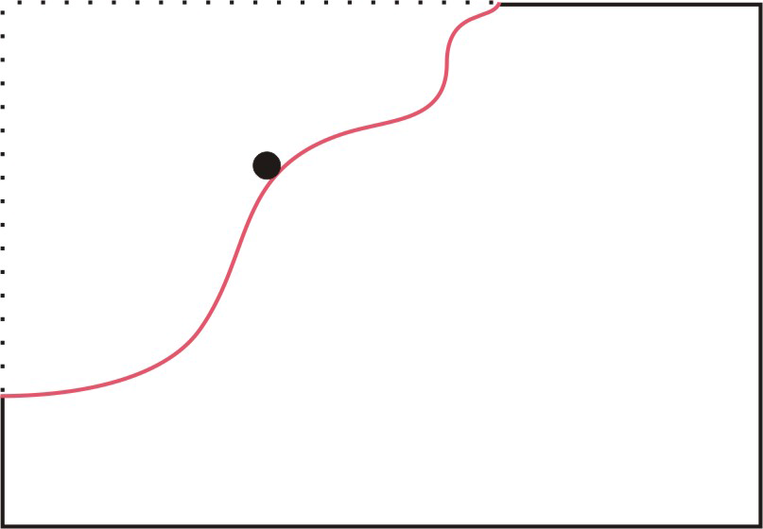
Motion Profiles
Contouring
Contouring gives considerable flexibility, due to the simultaneous control of more than one moving axis.
Relative motion between the work piece and the tool is controlled to generate the required geometry.
The tool path is offset from the required cutting path.

Slide 21
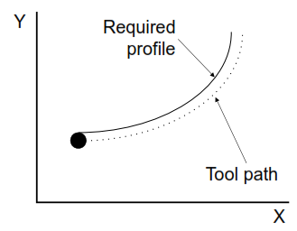
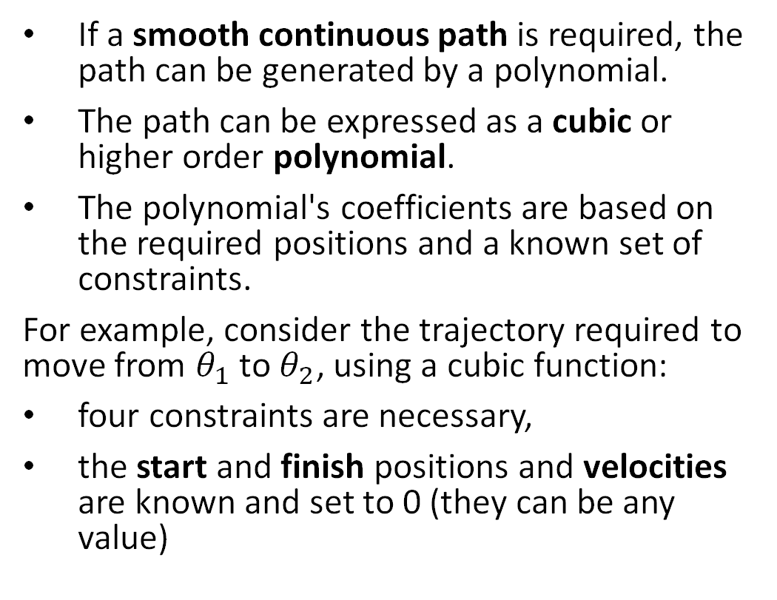
Motion Profiles
Polynomial Profile
If a smooth continuous path is required, the path can be generated by a polynomial.
The path can be expressed as a cubic or higher order polynomial.
The polynomial's coefficients are based on the required positions and a known set of constraints.
For example, consider the trajectory required to move from $θ_{1}$ to $θ_{2}$, using a cubic function:
four constraints are necessary,
the start and finish positions and velocities are known and set to 0 (they can be any value)

Slide 22
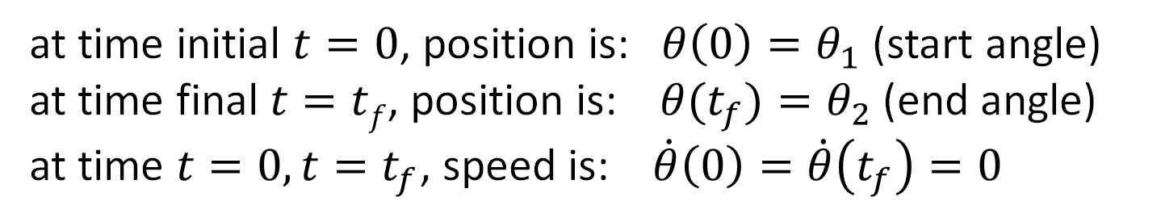
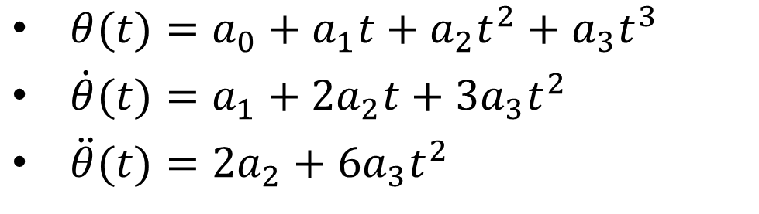
Motion Profiles
Solution : Polynomial
Position
$θ(t)=a_{0}+a_{1}t+a_{2}t^{2}+a_{3}t^{3}$
$\dot{θ}(t)=a_{1}+{2a}_{2}t+3a_{3}t^{2}$
$\ddot{θ}(t)={2a}_{2}+6a_{3}t^{2}$
derivative
Speed
derivative
Acceleration
at time initial $t=0$, position is: $θ\left(0\right)=θ_{1}$ (start angle)
at time final $t=tf$, position is:$θ(t_{f})=θ_{2}$ (end angle)
at time $t=0, t=t_{f}$, speed is: $\dot{θ}\left(0\right)=\dot{θ}\left(t_{f}\right)=0$

Slide 23
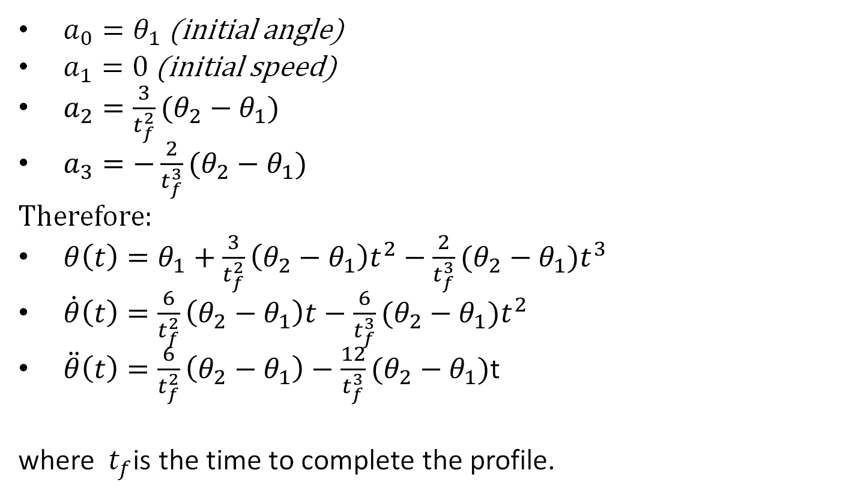
Motion Profiles
Solution : Polynomial
$a_{0}=θ_{1}$ (initial angle)
$a_{1}=0$ (initial speed)
$a_{2}=\frac{3}{t_{f}^{2}}(θ_{2}−θ_{1})$
$a_{3}=−\frac{2}{t_{f}^{3}}(θ_{2}−θ_{1})$
Therefore:
$θ\left(t\right)=θ_{1}+\frac{3}{t_{f}^{2}}\left(θ_{2}−θ_{1}\right)t^{2}−{\frac{2}{t_{f}^{3}}(θ_{2}−θ_{1})t}^{3}$
$\dot{θ}\left(t\right)=\frac{6}{t_{f}^{2}}\left(θ_{2}−θ_{1}\right)t−\frac{6}{t_{f}^{3}}(θ_{2}−θ_{1})t^{2}$
$\ddot{θ}\left(t\right)=\frac{6}{t_{f}^{2}}\left(θ_{2}−θ_{1}\right)−\frac{12}{t_{f}^{3}}(θ_{2}−θ_{1})$t
where${ t}_{f}$is the time to complete the profile.

Slide 24
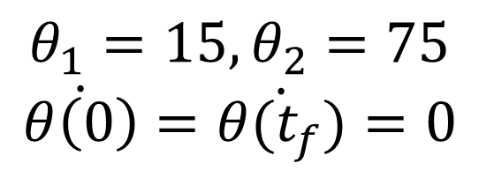
Motion Profiles
Polynomial move, example
Position
$$θ_{1}=15, θ_{2}=75$$
$$\dot{θ\left(0\right)}=\dot{θ(t_{f})}=0$$
Speed
Acceleration

Slide 25
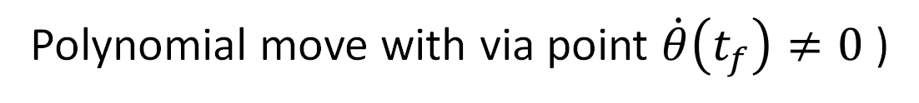
Motion Profiles
Polynomial move with via point $\dot{θ}\left(t_{f}\right)≠0$ )

